Slide 1
CHE 352A PROJECT
160651 SHIVALI AGRAWAL

Slide 2
Problem Statement
Objective: To simulate a multicomponent distillation column using Naphtali and Sandholm Newton-Raphson algorithm.
Given: Feed composition, Distillation column details.
Thermodynamic Models: WILSON model for activity coefficients, Redlich-Kwong for vapour phase fugacity coefficients and vapour enthalpy departure function.
Convergence method: Newton-Raphson
To Find: Block temperature profile, vapour and liquid compositions at each stage.

Slide 3
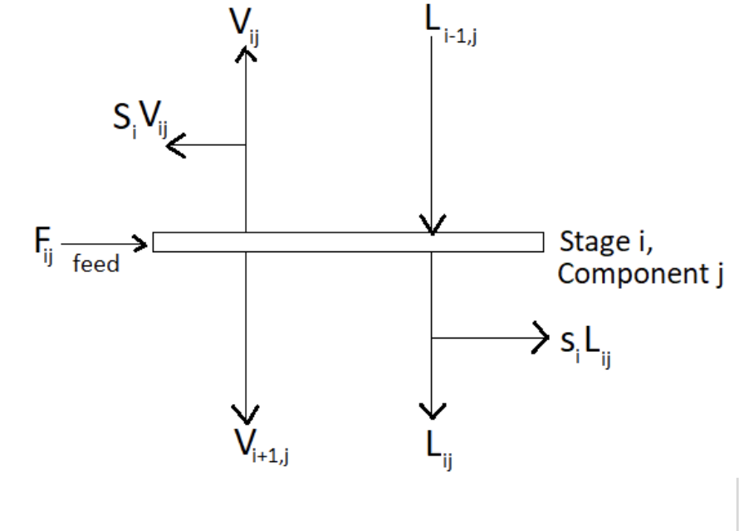
Naphtali Sandholm Algorithm for multicomponent distillation
NS equations with Murphree plate efficiency-
Material Balance (M) :
M_{ij} = ( 1 + S_{i}) * V_{ij} + (1 + s_{i}) * L_{ij} - V_{i+ 1,j} - L_{i-1,j} - f_{ij}
Equilibrium Relations (E) :
Q_{ij} = (n_{i} * K_{ij} * V_{i} * L_{ij} / L_{i}) - V_{ij} + ((1 - n_{i}) * V_{i+1,j} * V_{i} / V_{i+1})
Enthalpy Balance (H):
E_{i} = (1 + S_{i}) * H_{i} + (1 + s_{i}) * h_{i} - H_{i+1}- h_{i-1}- h_{ji}
Murphree Plate Efficiency Equation : n_{i} * K_{ij} * x_{ij} - y_{ij} + (1 - n_{i}) * y_{i+1,j} = 0
.

Slide 4
Degree of Freedom Analysis
Variables → (11+3c)N-1:
Number of stages (N) : 1
Temperature and Pressures of each stage: 2N
Temperature and Pressure of each Feed: 2N
Q for each stage: N
F, W, U, V, L for each stage: 5N
Tray efficiency for stage inside the column: N-2
Mole fractions of components (Vapour, Liquid, Feed) on each stage: 3cN
Equations → (2c+3)N:
Material balance of each component on each plate: cN
Equilibrium relation for each component on each plate : cN
Summation equations: 2N
Enthalpy balance on each plate: N
Degrees of Freedom: Variables - Equations= (c+8)N-1
Specified in problem → (c+8)N-1:
Number of stages (N) : 1
Feed rates and Feed composition on each stage: N+cN
Pressures of Feeds and Stages: N+N
Temperature of Feeds: N
Q each stages inside the column (which are all zero): N-2
Reflux ratio and Bottom flow rate: 2
Tray efficiency for stages inside the column: N-2
Vapour and Liquid side streams all zero: 2N
Since we have specified DoF variables, our problem is properly defined and we can proceed with solving.

Slide 5
APPROACH
1) Guess the initial matrix X using Rachford-rice algorithm for vapour and liquid compositions and linearly interpolate the temperature profile.
2) Calculating the matrix F by obtaining the enthalpy, material, equilibrium equations (MEH equations) for every stage.
3) Making of the derivative matrix dF/dx by calculating A, B and C matrices.
4) Applying Newton-Raphson algorithm to update the value of X.
5) Iterate till convergence.

Slide 6
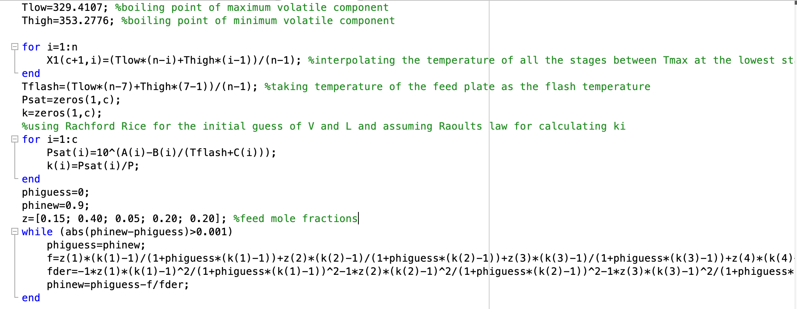
Initialisation of the X matrix
Guess for Temperature: Linear interpolation between the maximum to minimum boiling point from lowest to highest stage.
Guess for liquid and vapour fractions: Using Rachford-Rice algorithm considering the entire column as a single flash (with T_flash=T_feed-plate).
For the above step, the liquid and vapour mixtures were assumed to be ideal and therefore k=Psat(T)/P.

Slide 7
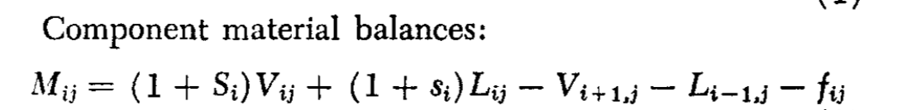
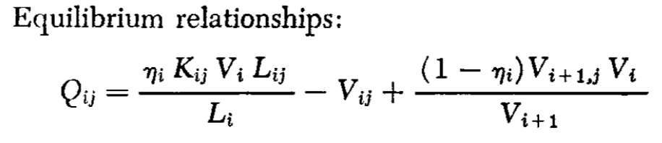
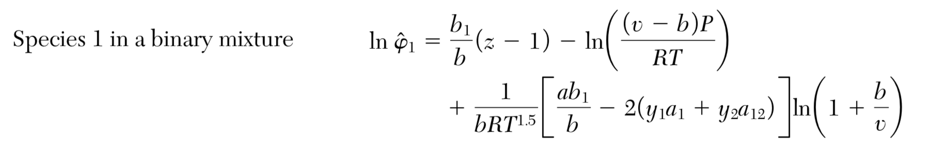
MEH equations for the F matrix
Material Balance equations for each component at every stage (given by the function: ‘Material.m’):
Equilibrium equations for each component at every stage (given by the function: ‘Eij_RK.m’)
Fugacity coefficients are calculated using Redlich Kwong equation of state using the following eqn.
a and b are calculated by mixing rules

Slide 8
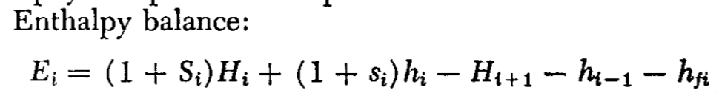
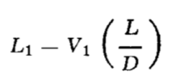
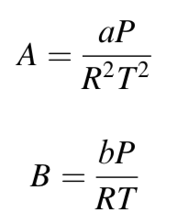
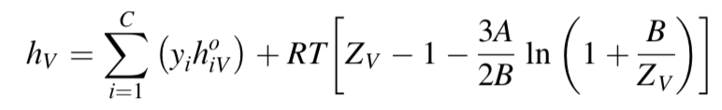
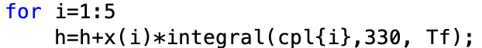
Enthalpy Equation for each stage: (given by the function ‘hj.m’)
These 2 equations are used for the enthalpy balance for the first and the last stage respectively because Q values were not given
, L - B
Enthalpy of vapour is calculated as:
Here, T=330K is taken as the reference temperature
Where the enthalpy departure functions are calculated as:
where,
Enthalpy of liquid is calculated as:

Slide 9
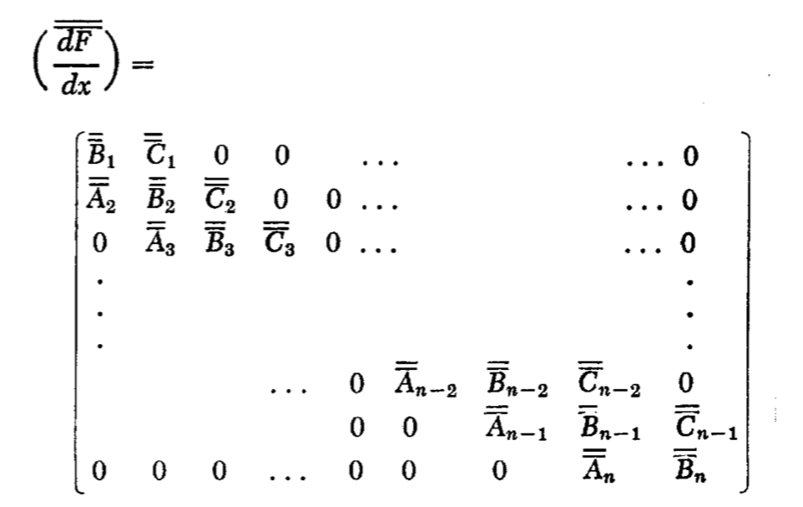
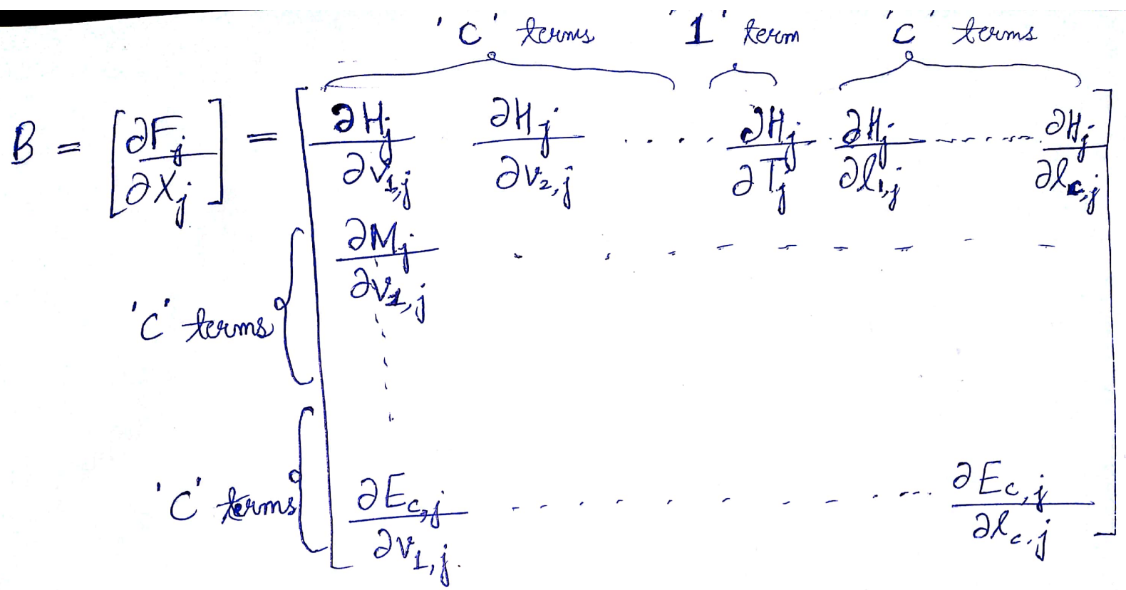
Making the df/dx matrix
The df/dx matrix (209 X 209) is calculated by computing the matrices Aj, Bj, Cj → which are Jacobian of the Fj with respect to Xj-1,Xj and Xj+1 respectively.
The derivatives of the Hj, Mij and Eij equations w.r.t vij, Tj and lij were required for the computation of the A, B, C matrices. For this central difference method was used for numerical differentiation.

Slide 10
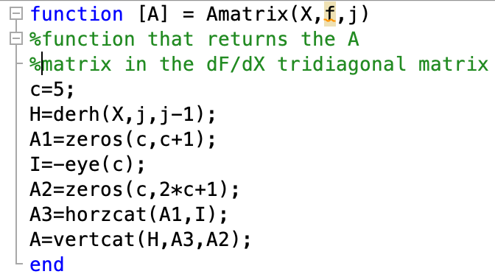
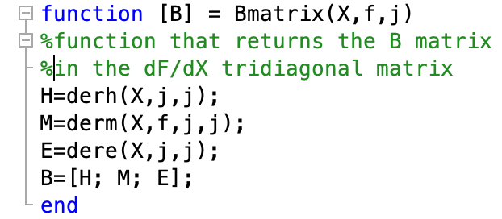
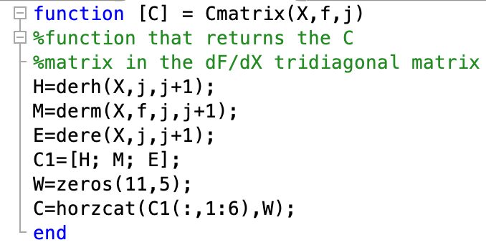
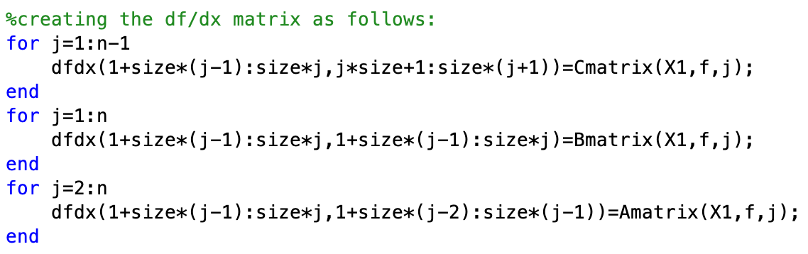

Slide 11
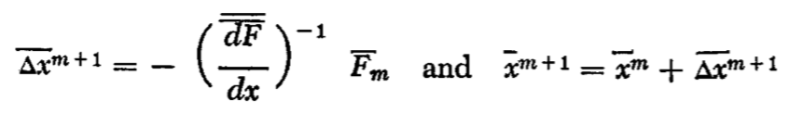
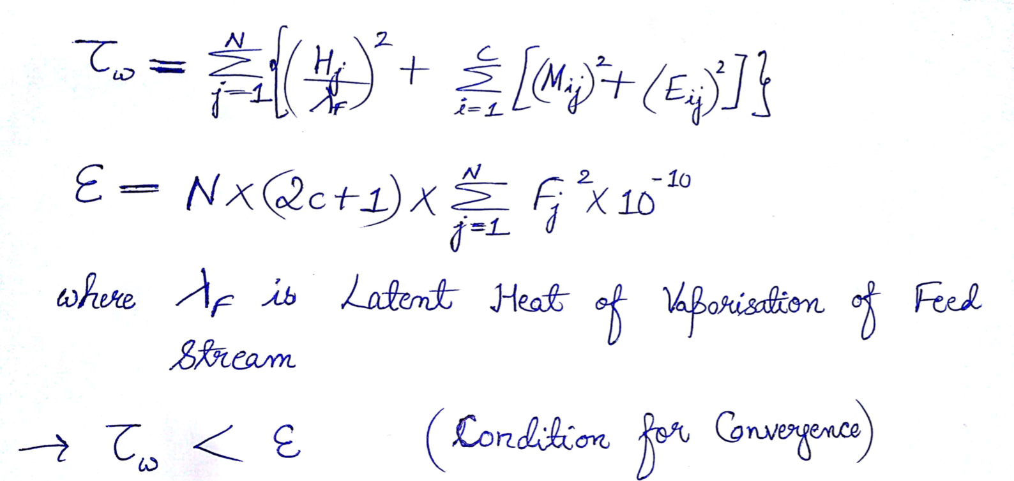
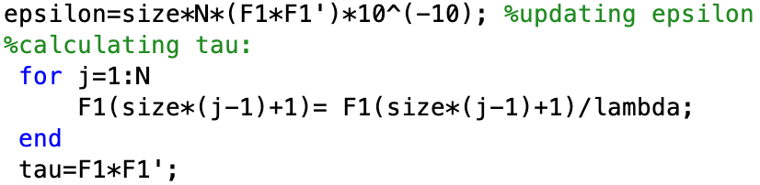
Convergence
Used Newton Raphson algorithm for updating the value of X matrix.
The convergence is achieved when tau becomes less than epsilon.

Slide 12
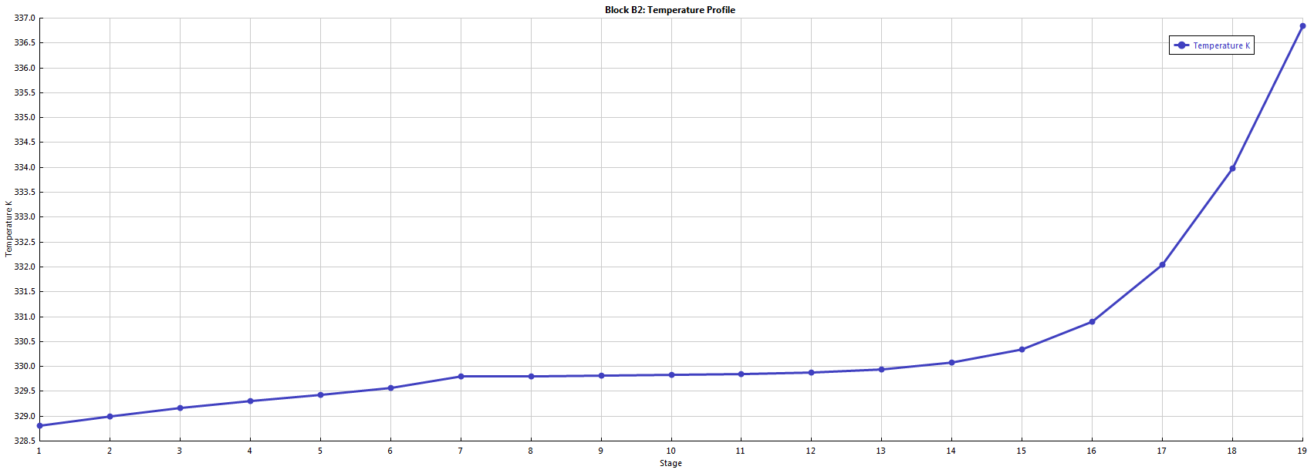
ASPEN Results
Block Temperature Profile:

Slide 13
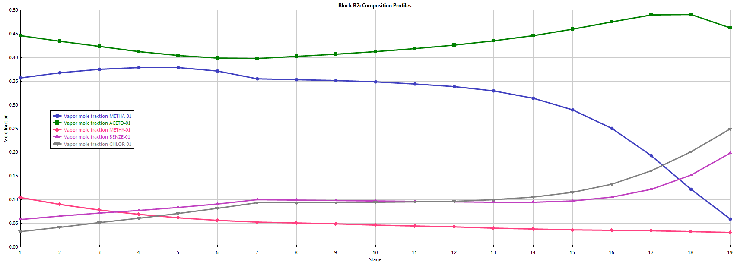
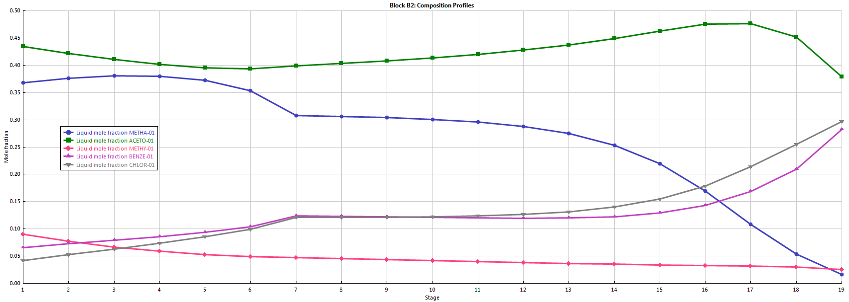
Liquid Composition Profile
Vapour Composition Profile

Slide 14
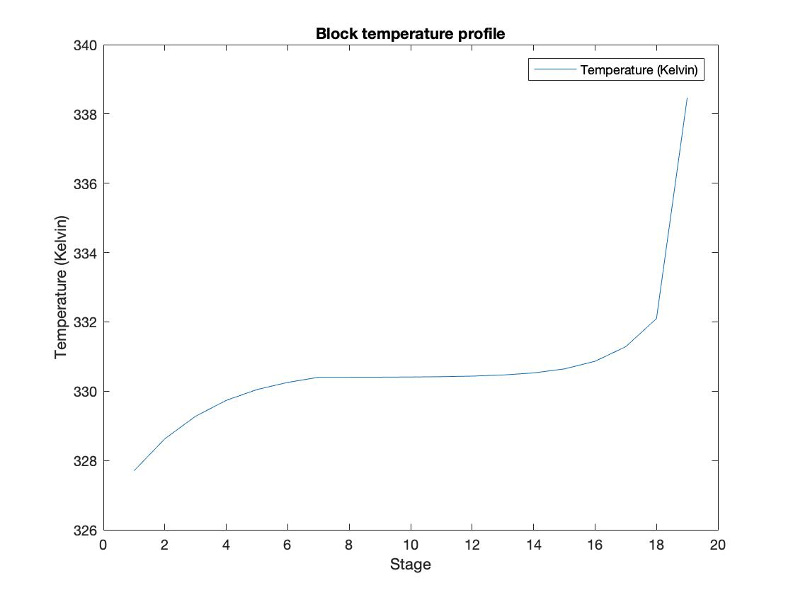
MATLAB Results- Block Temperature Profile

Slide 15
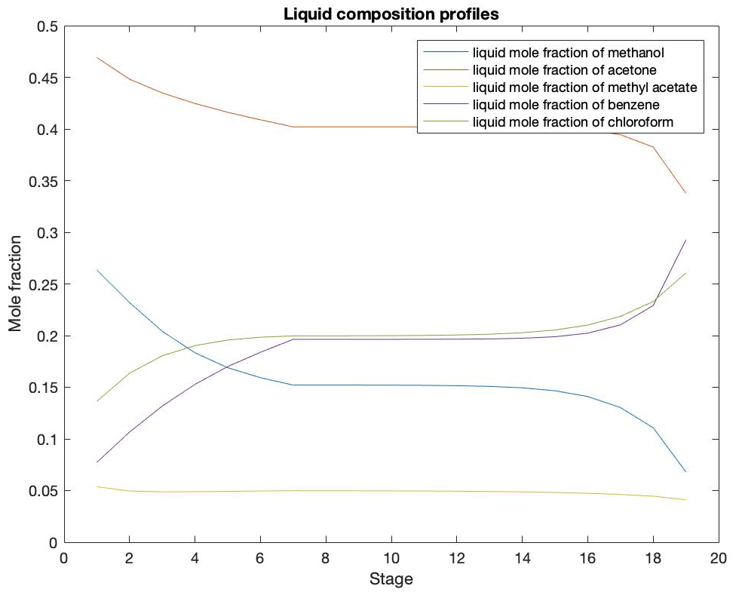
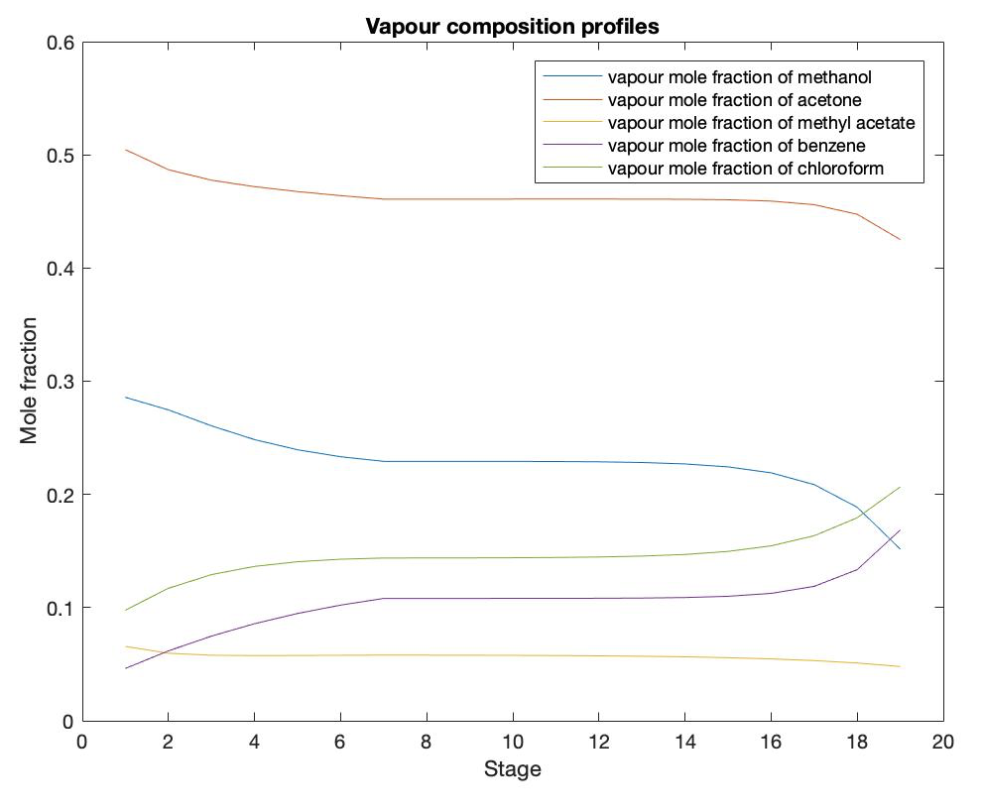
Concentration Profiles (MATLAB)

Slide 16
References
[1] Naphtali, L. M. & Sandholm, D. P. Multicomponent Separation Calculations. (1971).
[2] Seader, Junior D., Ernest J. Henley, and D. Keith Roper. "Separation process principles." (1998).
[3] Koretsky, Milo D. Engineering and chemical thermodynamics. Vol. 2. New York: Wiley, 2004.
[4] Gmehling and Onken, Vapor-Liquid Equilibrium Data Collection, DECHEMA Chemistry Data ser., vol. 1 (parts 1–10), Frankfurt, 1977.
[5] Perry, John H. "Chemical engineers' handbook." (1950): 533.
[6] R. L. Rowley, W. V. Wilding, J. L. Oscar- son, Y. Yang, N. A. Zundel, T. E. Daubert, R. P. Danner, DIPPR® Data Compilation of Pure Chemical Properties, Design Institute for Physical Properties, AIChE, New York (2007).
[7] https://in.mathworks.com/help/matlab/
[8] Aspen Plus 8.8 (2001) by Aspen Technology.

